Slide 2

Your Name
Your Role, Your Company
Interesting Fact

Slide 4
Chapter Goals
Introduction to Infrastructure as Code
Provision to Azure
Basic Blocks of Terraform
Fire It Up!
Quiz

Slide 5
Introduction

Slide 6
What is Infranstructure as Code
Infrastructure as Code (IaC) is the process of managing and provisioning computer data centers through machine-readable definition files.

Slide 7
Infrastructure as Code
Provide a codified workflow to create infrastructure
Expose a workflow for managing updates to existing infrastructure
Integrate with application code workflows (Git, SCM, Code Review)
Provide modular, sharable components for separation of concerns

Slide 8
Provisioning a Virtual Machine
Name
Operating System (Image)
Size
Location
Username and Password

Slide 9
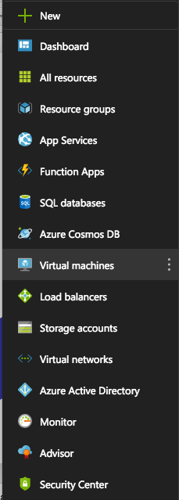
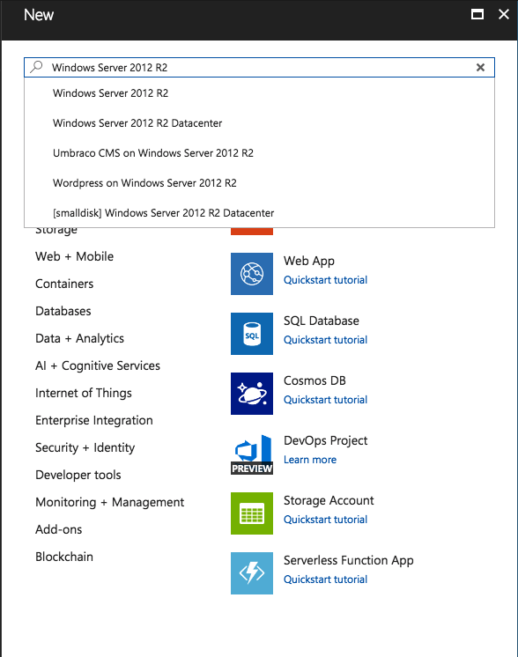

Slide 10
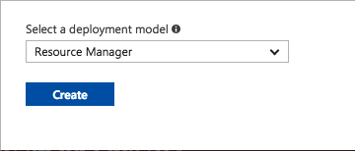

Slide 11
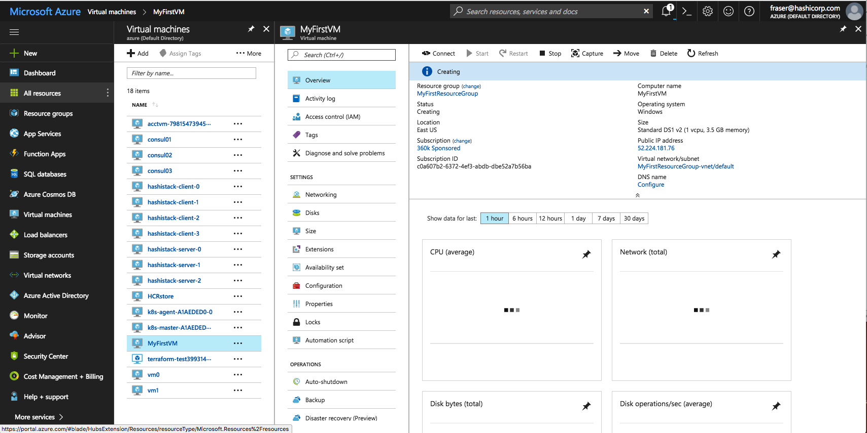

Slide 12
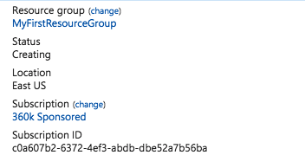
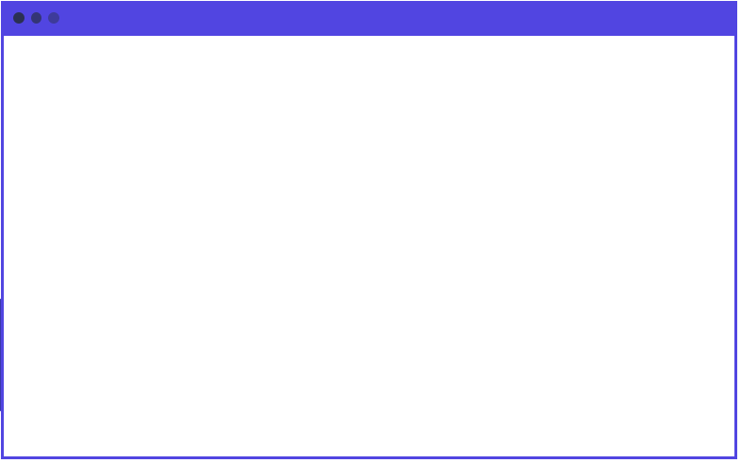
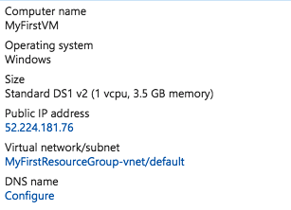
main.tf
resource ”azure_instance” “web” {
name = “MyFirstVM”
image = “Windows 2012 R2”
size = “Standard DS1”
location = “East US”
username = “John Doe”
password = “Iamrootfearme!”
}

Slide 13
main.tf
resource ”azure_instance” “web” {
name = “MyFirstVM”
image = “Windows 2012 R2”
size = “Standard DS1”
location = “East US”
username = “John Doe”
password = “Iamrootfearme!”
}

Slide 14
What is Terraform
Terraform is a tool for building, changing, and versioning infrastructure safely and efficiently.

Slide 15
Terraform and Infrastructure as Code
Infrastructure is described using a high-level configuration syntax. This allows a blueprint of your datacenter to be versioned and treated as you would any other code. Additionally, infrastructure can be shared and re-used.

Slide 16
Infrastructure as Code (Terraform)
Human-readable configuration (HCL) is designed for human consumption so users can quickly interpret and understand their infrastructure configuration.
HCL includes a full JSON parser for machine-generated configurations.

Slide 17
main.tf
resource "azurerm_resource_group" “myfirstrg” {
name = ”myfirstresourcegroup"
location = ”East US”
}

Slide 18

Azure - Resource Group
A container (not that container) that holds related resource for an Azure solution;
The resource group can include all resources for the solution or only those you want to manage as a group
You decide how you want to allocate resources to resource groups based on what makes sense for you!

Slide 19
Azure - Resource
A manageable item that is available through Azure. Some common resources are;
Virtual machine
Storage Account
Virtual Network/Subnet

Slide 20
Group Lab
Terraform Init
Terraform Plan
Terraform Apply

Slide 21
Exercise: Run terraform init
Run the terraform init command to download the required providers.

Slide 22
$ terraform init
Initializing provider plugins...
Checking for available provider plugins on http://release…
- Downloading plugin for provider "azurerm" (0.3.3)...
The following providers do not have any version constraints in configuration,so the latest version was installed.
To prevent automatic upgrades to new major versions that may contain breakingchanges, it is recommended to add version = "..." constraints to thecorresponding provider blocks in configuration, with the constraint stringssuggested below.
provider.azurerm: version = "~> 0.3”
Terraform has been successfully initialized!

Slide 23
Terraform Init
You must run terraform init after adding or removing providers.
You do not need to run terraform init before each command.
Similar to git init.

Slide 24
Exercise: Run terraform help
Run terraform help to generate the full list of Terraform commands.

Slide 25
$ terraform help
Common commands:
apply Builds or changes infrastructure
console Interactive console for Terraform interpolations
destroy Destroy Terraform-managed infrastructure
env Workspace management
fmt Rewrites config files to canonical format
get Download and install modules for the configuration
graph Create a visual graph of Terraform resources
import Import existing infrastructure into Terraform
init Initialize a Terraform working directory
output Read an output from a state file
plan Generate and show an execution plan
providers Prints a tree of the providers used in the config
push Upload this Terraform module to Atlas to run
refresh Update local state file against real resources
show Inspect Terraform state or plan
taint Manually mark a resource for recreation

Slide 26
$ terraform help
Common commands:
apply Builds or changes infrastructure
console Interactive console for Terraform interpolations
destroy Destroy Terraform-managed infrastructure
env Workspace management
fmt Rewrites config files to canonical format
get Download and install modules for the configuration
graph Create a visual graph of Terraform resources
import Import existing infrastructure into Terraform
init Initialize a Terraform working directory
output Read an output from a state file
plan Generate and show an execution plan
providers Prints a tree of the providers used in the config
push Upload this Terraform module to Atlas to run
refresh Update local state file against real resources
show Inspect Terraform state or plan
taint Manually mark a resource for recreation

Slide 27
Command: terraform plan
The plan shows you what will happen
You can save plans to guarantee what will happen
Plans show reasons for certain actions (such as re-create)
Prior to Terraform, users had to guess change ordering, parallelization, and rollout effect

Slide 28
Command: terraform plan
+ indicates a resource will be created
- indicates a resource will be destroyed
~ indicates a resource will be updated in-place
-/+ indicates a resources will be destroyed and re-created

Slide 29
Exercise: Run terraform plan
Run terraform plan on the Terraform files created in the previous section. Leave the output on the screen for the instructor to see.

Slide 30
$ terraform plan
+ azurerm_resource_group.myfirstrg
id: <computed>
location: "eastus"
name: "myfirstresourcegroup"
tags.%: <computed>
Plan: 1 to add, 0 to change, 0 to destroy.

Slide 31
Command: terraform apply
Executes changes in order based on the resource graph
Parallelizes changes when possible
Handles and recovers transient errors
Notes:
The next step in performing changes with Terraform is to perform the Terraform apply. The apply is when the infrastructure operations are actually performed.
Using the resource graph defined by our configuration, Terraform determines the order in which to perform our changes, parallelizes the change when possible, and will handle known timing and transient errors when it can.
As an example, for a more complex configuration, Terraform can create EC2 instances that have no dependencies in parallel and will handle provider errors such as checking for the existence of an instance that was just created, as can happen when making fast changes.

Slide 32
$ terraform apply
azurerm_resource_group.myfirstrg: Creating...
location: "" => "eastus"
name: "" => "myfirstresourcegroup"
tags.%: "" => "<computed>”
azurerm_resource_group.myfirstrg: Creation complete after 2s (ID: /subscription/resourceGroups/MyFirstResourceGroup)
Apply complete! Resources: 1 added, 0 changed, 0 destroyed.
Notes:
Here is some sample output.

Slide 33
Command: terraform apply
Updates existing resources when updates are allowed
Re-creates existing resources when updates are not allowed
Notes:
An important note about Terraform, is that Terraform knows what changes it can apply to existing resources and what changes require that a resource is re-created - meaning a new resource will be created and the previous resource will be destroyed.
It is important to use the Terraform plan to know when these scenarios will occur to anticipate, and account for, potential service interruptions.

Slide 34
Individual Challenge!
Navigate to terraform.io/docs/providers/azurerm/index.html
Find the azurerm_resource_group
Add a tag to your resource group called “Production”
Ask for help! (neighbour, colleague, phone a friend, instructor)

Slide 35
main.tf
resource "azurerm_resource_group" “myfirstrg” {
name = ”myfirstresourcegroup"
location = ”East US”
tags {
environment = "Production"
}
}

Slide 36
$ terraform plan
-/+ azurerm_resource_group.myfirstrg (new resource required)
id: "/subscriptions/sresourceGroups/MyFirstResourceGroup" => <computed> (forces new resource)
location: "eastus" => "eastus"
name: "MyFirstResourceGroup" => "myfirstresourcegroup" (forces new resource)
tags.%: "0" => "1"
tags.environment: "" => "Production”
Plan: 1 to add, 0 to change, 1 to destroy.

Slide 37
$ terraform apply
azurerm_resource_group.myfirstrg: Destroying... (ID: /subscription/resourceGroups/MyFirstResourceGroup)
location: "" => "eastus"
name: "" => "myfirstresourcegroup"
tags.%: "" => "1"
tags.environment: "" => "Production"
azurerm_resource_group.myfirstrg: Creation complete after 1s (ID: /subscriptions/resourceGroups/myfirstresourcegroup)
Apply complete! Resources: 1 added, 0 changed, 1 destroyed.
Notes:
Here is some sample output.

Slide 38
Accomplished
Introduction to Infrastructure as Code
Learned what an Azure Resource Group is
Provisioned our First Resource Group to Azure

Slide 39
Quiz
What is an Azure Resource Group?
What is Infrastructure as Code?
What are the two Terraform commands and how do they differ?
What command allows you to format Terraform Code?

Slide 40
Questions?

